Slide 1
When will Leaders of Developing Countries Negotiate South-North Preferential Trade Agreements?
Lucie Lu Department of Political Science
University of Illinois at Urbana-Champaign
Notes:
Hi

Slide 2
Outline of Today’s Presentation
Introduction and Research Question
Context and Rationale
Theory: The Logic of Economic Reforms
Power dynamics between oppositions and leaders
Research Design
Empirical Findings at this Stage
Tentative Conclusions
Questions and Comments

Slide 3
Introduction
Case of South Africa in 1994: PTA with EU helped with the economic transition in South Africa
Preferential trade agreements (PTAs) are binding international treaties that help states to foster trade and economic integration among member-states.
Focus: Bilateral South-North Preferential Trade Agreements

Slide 4
Research question
Under what conditions will leaders in the developing countries negotiate the South-North Preferential Trade Agreements with required structural economic reforms?

Slide 5
Context and Rationale
Current literature on the preferential trade agreement mainly focuses on the effects of this institution.
In contrast, explain why states form the PTAs:
The political purposes of the leaders in the developing countries to sign trade treaties are currently understudied.

Slide 6
Context and Rationale
The puzzles are: What motivates leaders to participate in this costly game? When is the optimal time to do so?
This paper focuses on the strategic behaviors of leaders to form PTAs to consolidate their power vis-à-vis the opposition.

Slide 7
Theory: The Logic of Economic Reforms
Leaders of developing countries: they anticipate a forthcoming structural economic transformation before the negotiation.
Domestic economic reforms usually provoke controversy and organized opposition.
PTA is an effective instrument for promoting such economic reform.
Argument: The leaders in the developing countries choose to sign the PTAs to lock in the economic reforms for the primary goal of political survival.

Slide 8
Research Design
Quasi-experiment:
Treatment: leaders with insecure shocks
Empirically, how should I conceptualize an insecure shock?
Measuring a leader’s secureness at time 0 and over time
Unit of analysis: leader in the developing countries
This dataset covers 293 leaders in 61 developing countries between 1995-2005.
Compares the likelihoods of leaders with insecure shocks and without the insecure shocks to negotiate the South-North PTAs.

Slide 9
Research Design
Cases: 81 events out of 293 total observations.
It excludes leaders in the liberal democracies (V-Dem’s Electoral Democracy Index above 0.75) where a more demanding notion of democracy that the rule of law and constraints on the executives are respected.
This dataset also excludes 7 cases where the PTA negotiation (event) happened before the insecure shock (treatment).
Furthermore, it removes leaders whose tenure is less than one year, in such case they have no time to pursue any substantial policy changes given the short amount of time in office.

Slide 10
Research Design
Hypothesis:
Insecure shocks PTA Negotiation
Coding Strategies and Justifications:
Dependent Variable: South-North PTA negotiation
Independent Variable: insecure shocks
Control Variables:
Leaders’ tenure
GDP growth (potential covariate)
Human rights conditions (potential covariate)

Slide 11
Research Design
The hypothesized treatment in this study is an insecure shock that a leader experiences. There are two types of insecure shocks. Before getting into it, here I use two indices to measure the secureness of a leader in autocracies: 1) a leader’s securenss when he starts his tenure at time 0, and 2) the secureness of the regime when the leader holds office at time t.
So here are two types of insecureness shocks across regime types. However, note that in democracies, a leader’s relation to his past is irrelevant; hence, a leader is automatically assumed as a secure leader at time 0.
Type 1: a leader is secure at time 0 and becomes insecure immediately onward at time 1.
Type 2: a leader experiences an in-secureness shock during his tenure a time t.

Slide 12
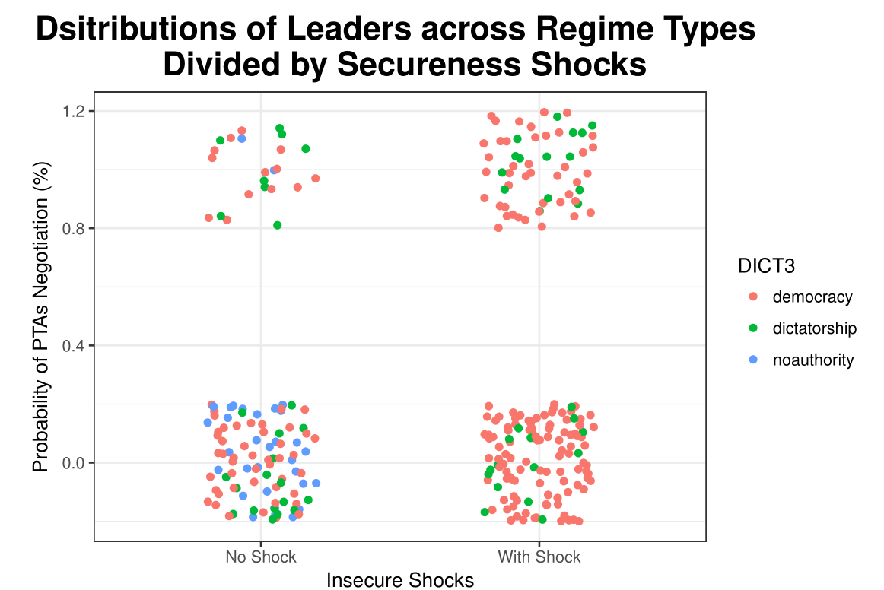
Empirical Findings: Data Description

Slide 13
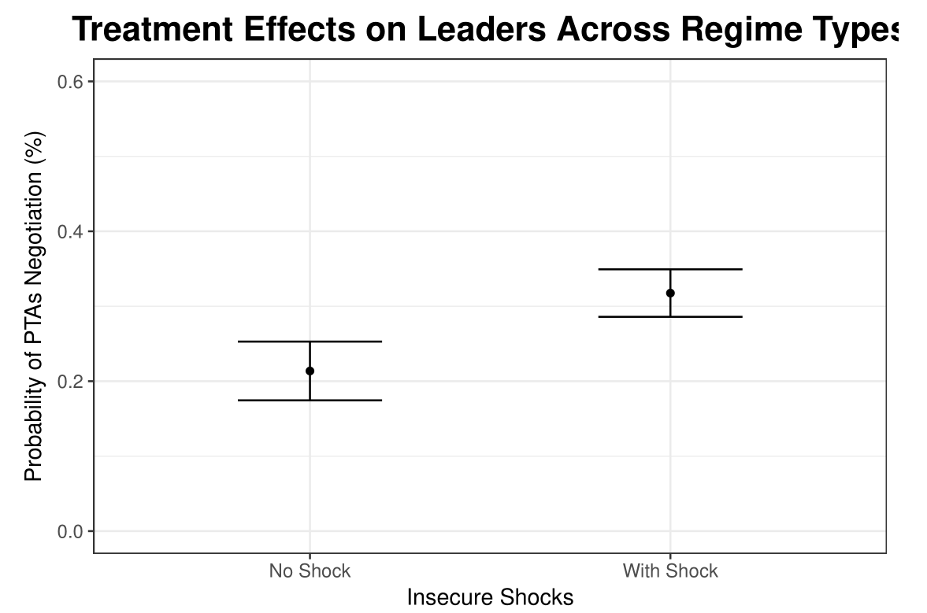
Empirical Findings: Treatment Effect with One Covariate
Holding leaders’ mean tenure constant, on average, without an insecure shock, a leader’s probability of negotiating a PTA is around 21.37%.
In contrast, those leaders who have experienced insecure shocks on average have 10.39% higher probability to negotiate a PTA than those without such “treatment”.

Slide 14
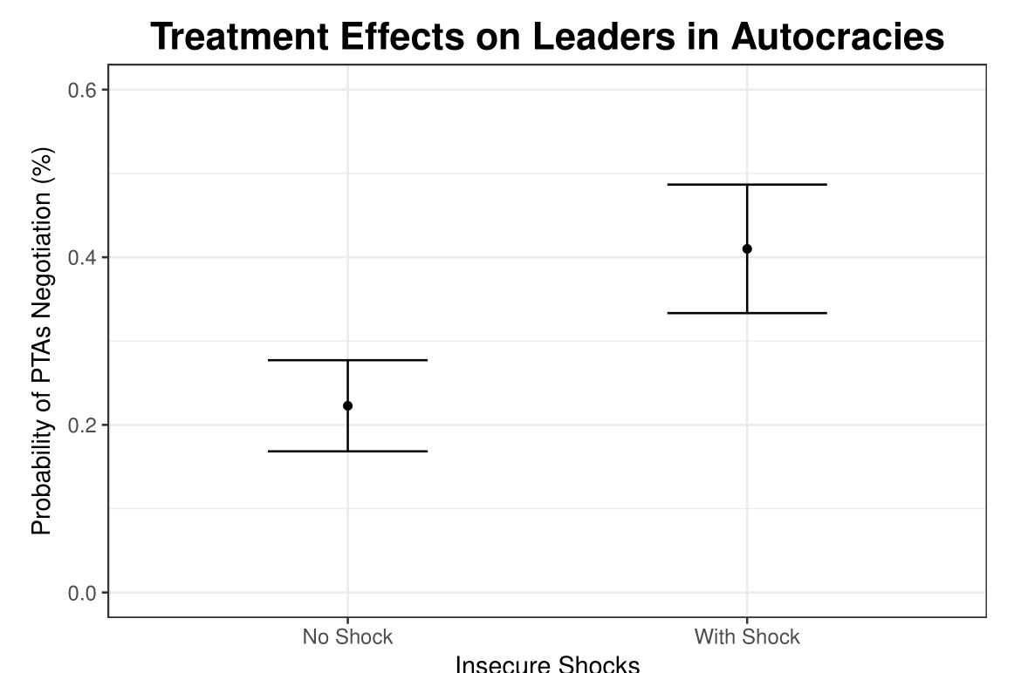
Empirical Findings: Treatment Effect with One Covariate
Holding leaders’ mean tenure constant, on average, without an insecure shock, a leader’s probability of negotiating a PTA in autocracies is around 22.28%.
In contrast, those leaders who have experienced insecure
shocks were on average have 41% probability to negotiate a PTA. The treatment effect (18.72%) is also statistically significant.

Slide 15
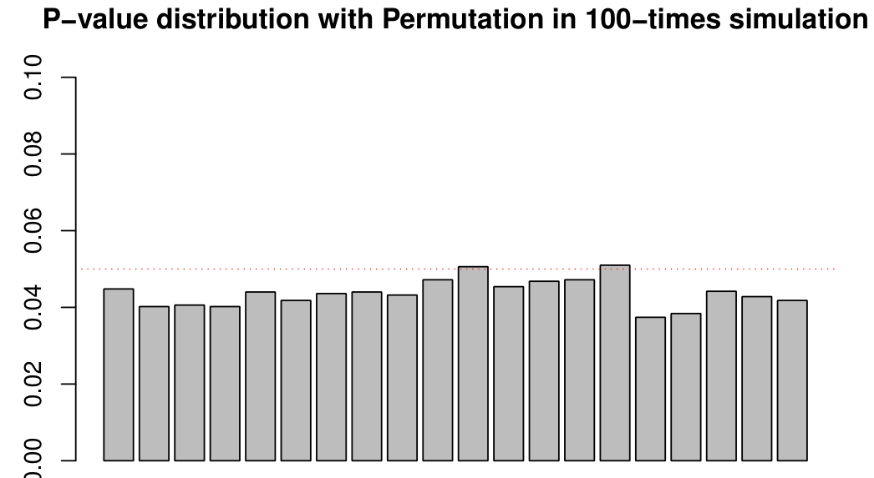
Empirical Findings: Treatment Effect with One Covariate
In autocracies:
Note that in democracies, holding tenure constant, a leader with insecure shock has higher probability of PTA to negotiate a PTA, as expected, but the treatment effect is around 5% with no statistical significance (the Fisher’s null is 0.406).
Preliminary conclusion:
My hypothesis is empirically supported.

Slide 16
Moving Forward
Questions at this stage:
1. Right now, the unit of analysis is leader. I want to incorporate the other two covariates (GDP growth and human rights conditions of the regimes across time span 1995-2015), I may need to
1) either collapse those data points for each leader;
2) notice whether there is a worsening economic or human rights condition, if yes, code as 1, otherwise 0;
3) do multilateral linear model/Bayesian analysis.
Do you have any suggestion about how to move forward?
2. Do you think it’s necessary to discuss the results by regime types?

Slide 17
Preliminary Conclusions
My hypothesis is empirically supported.
Next steps:
Expand the datasets to include unstable democracies cases
More concrete qualitative cases to test the theory
Notes:
hello

Slide 18
Questions and Comments are Greatly Appreciated! Thank you very much.

